Slide 1
Standards
Based
Grading
Presented by the WKMS Social Studies Department:
Jaime Thompson
Josh Work
Tiffany Malagari
Ryan Grove
Lorri McCadney
Notes:
Jaime - 1

Slide 2
session objective:
To cover the:
of standards based grading
Notes:
Jaime - 2

Slide 3
Notes:
Jaime - 3

Slide 4
Traditionally, grades are viewed as rewards, compensation, and/or the proverbial
“carrot on a stick”.
Notes:
Jaime - 4

Slide 5
“Grades are first and foremost communication; they are information, nothing more. The moment we make them something more we corrupt their constructive use.”
Rick Wormeli
Notes:
Jaime - 5

Slide 6
Why do Standards-Based Grading?
Traditional grading can result in grades that are a combination
of student behaviors and assignment completion.
Student #1:
always prepared
pays attention
completes all work
does extra credit
fails tests and quizzes
GRADE IN CLASS: B
Student #2:
comes unprepared
incomplete assignments
missing assignments
tends to be off-task
earns “A”s on tests
GRADE IN CLASS: C
These students have “earned” grades that are not reflective of their levels of content mastery.
Notes:
Jaime - 6

Slide 7
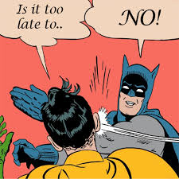
Grades are indicators of knowledge and mastery, not behavior.
Points should not be deducted for:
talking
not having a name on the paper
talking during presentations
lateness
following directions
Notes:
Jaime - 7

Slide 8
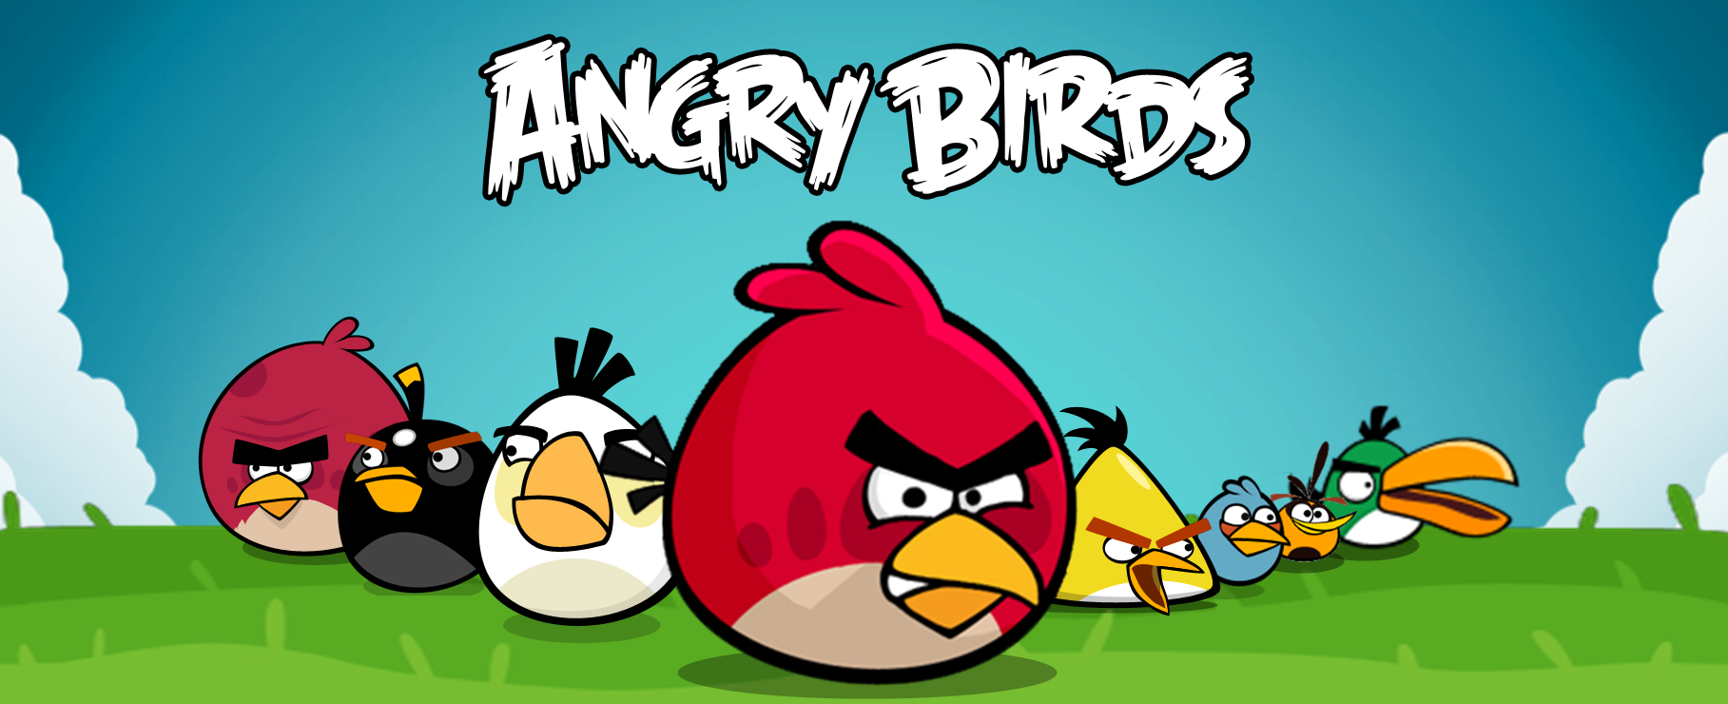
Let’s take a look at SBG,
style!
Notes:
Tiffany - 1

Slide 9
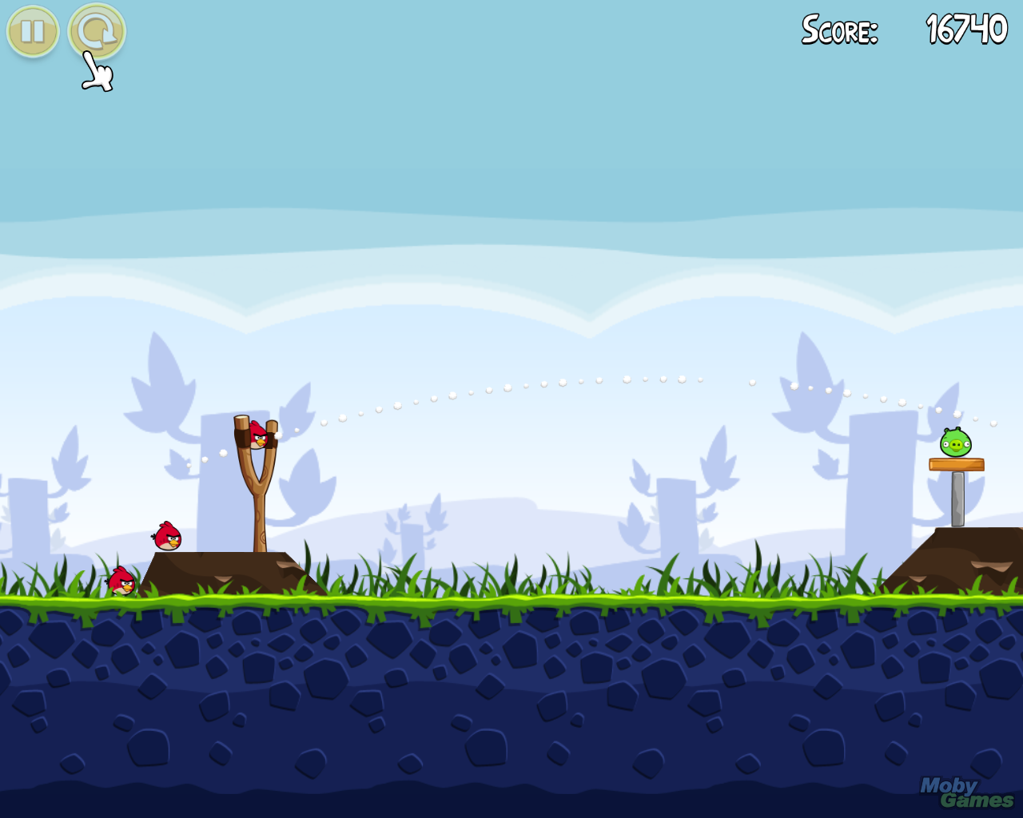
Angry Birds Standard:
Knock down the green pig using 3 or less angry birds.
Notes:
Tiffany - 2

Slide 10
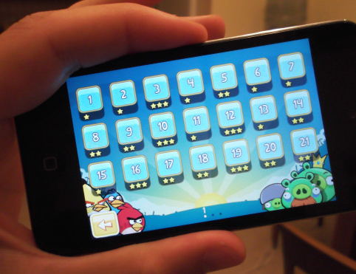
Traditional Grading using Angry Birds
Each level is an assignment
Imagine if you could only play each level once and you were stuck with that score.
Traditional grading focuses on assessment of task rather than concept or standard mastery.
Notes:
Tiffany - 3

Slide 11
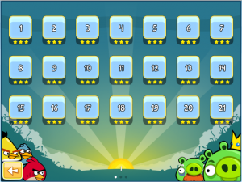
Standards-Based
using Angry Birds
Each level is a standard, not a task.
You are allowed to go back and play each level until you master it.
The focus is on concept/standard mastery
Notes:
Tiffany - 4

Slide 12
How the gradebook will change:
A snapshot of what parents and students see using traditional grading methods:
Using SBG, the assignment title is directly related to a standard or group of standards:
Worksheet #1 | 75%
Group Discussion | 100%
Vocab Quiz | 60%
Unit 1 Study Guide | 90%
Unit 1 Test | 65%
Major River Systems | 75%
Paleolithic vs. Neolithic Age | 100%
Characteristics of a Civilization | 65%
Development of City-States | 95%
Empire Achievements | 85%
Notes:
Amy - 10

Slide 13
Scale
Comparison:
STANDARDS-BASED
GRADING SCALE
100% | A | Advanced Mastery
95% | A | Complete Mastery
85% | B | Essential Mastery
75% | C | Basic Mastery
65% | D | Limited Mastery
55% | F | No Mastery
50% | F | No Attempt
90 - 100% | A
80 - 89% | B
70 - 79% | C
60 - 69% | D
59% & below | F
TRADITIONAL
GRADING SCALE
There are NO zeros when using SBG.
Notes:
Amy - 11

Slide 14
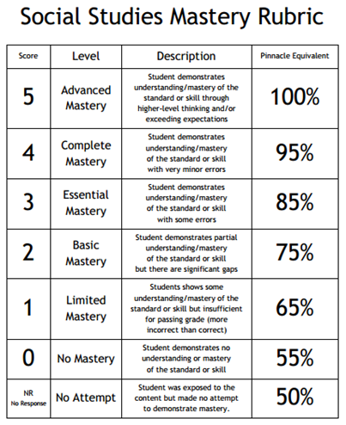
Gradebook scores are calculated based on a Social Studies rubric:
These are the only scores families will see on Pinnacle.
Grades no longer
fall in a range, they are set values.
Notes:
Tiffany - 9

Slide 15
Why are there no “zeros” in sbg?
93, 93, 93, 0 = 69.75%
93, 93, 93, 50 = 82.25%
Which scenario above
is more reflective of
the student’s level of comprehension?
Notes:
Amy - 12

